Slide 1
Romanticism and Modern Literature
William Blake
“London”
September 10, 2024

Slide 2
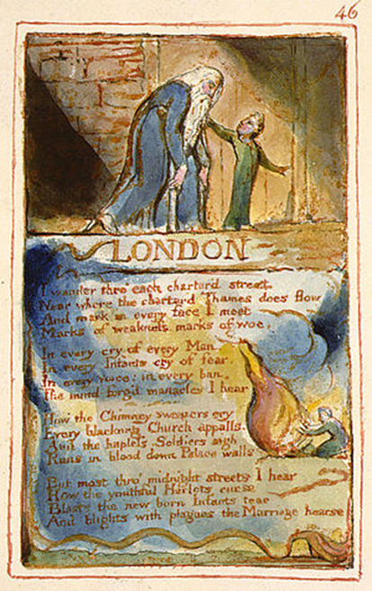
London
Topographical Poetry
“Mind-forged Manacle”
Impressment
Poor relief
Notes:
)

